Slide 1
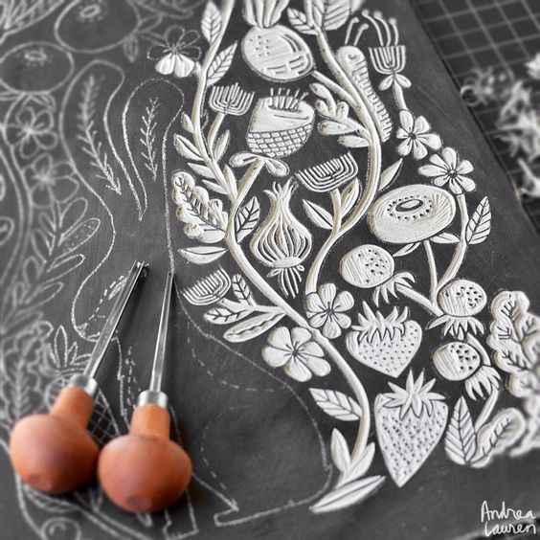
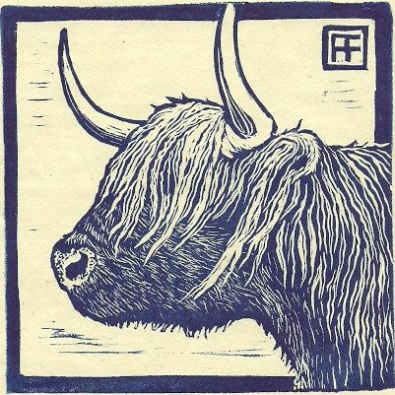
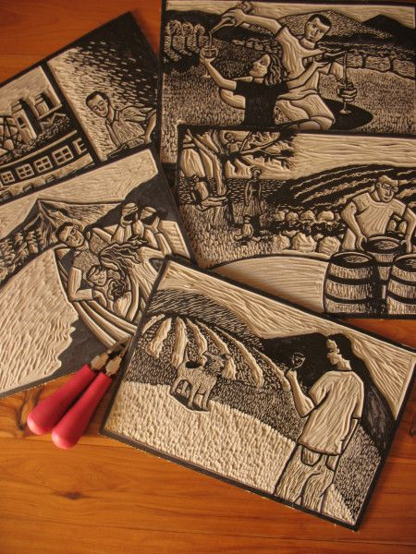
intagme.com
Lino Printing

Slide 2
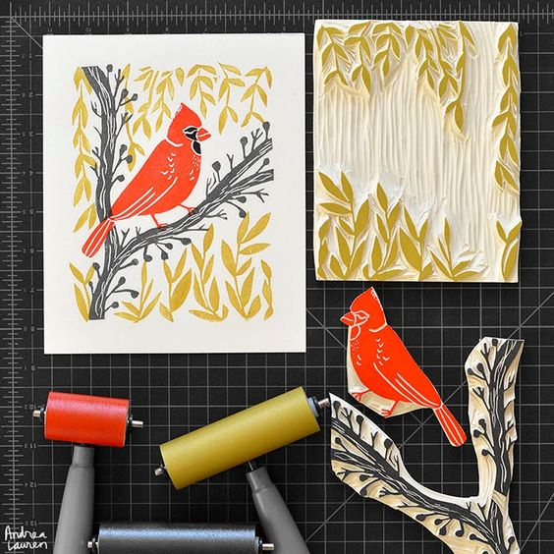
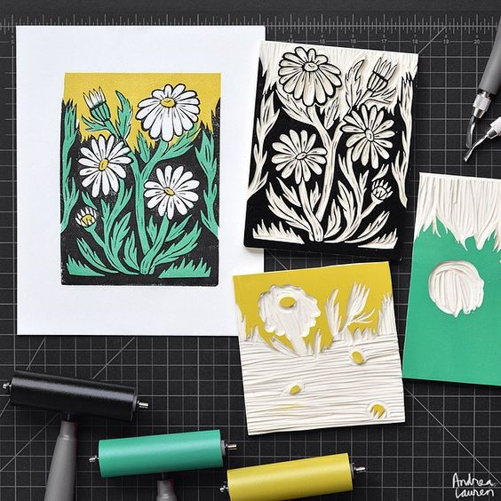

Slide 3
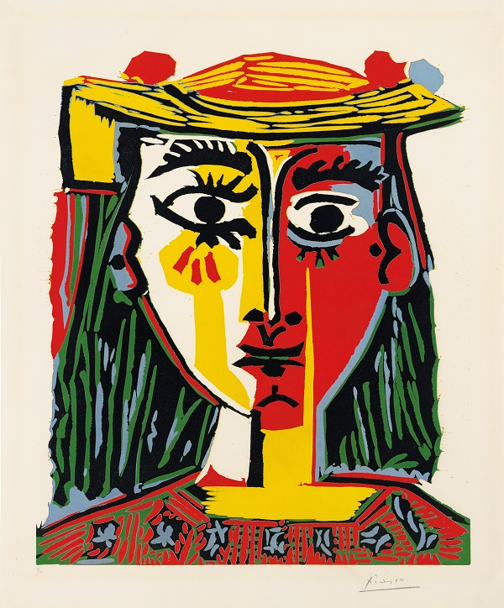
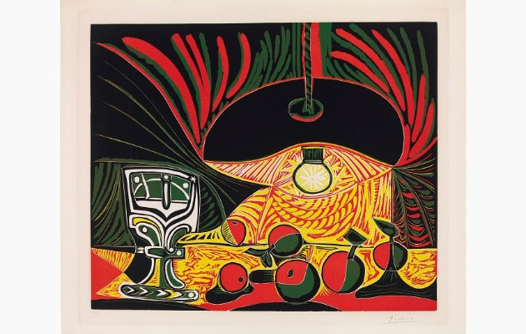
Picasso and the Linocut
Linocuts form a relatively small part of Picasso’s oeuvre as a printmaker, however some of his most outstanding compositions were produced using this method in a short burst of activity between 1958 and 1963. It was a combination of geographic necessity and artistic curiosity which led the artist, at the age of 78, to turn away from etching and lithography – hitherto his favourite means of graphic expression – and take up the linocut technique..
https://www.christies.com/features/Picasso-and-the-linocut-5770-1.aspx

Slide 4
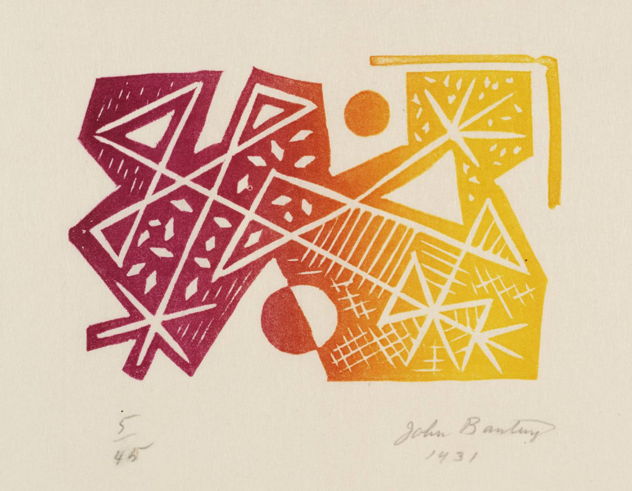
Georg Baselitz, ‘Drinker’ 1981
Georg Baselitz
Drinker 1981
Tate
© Georg Baselitz
The lino block consists of a thin layer of linoleum (a canvas backing coated with a preparation of solidified linseed oil) usually mounted on wood. The soft linoleum can be cut away more easily than a wood-block and in any direction (as it has no grain) to produce a raised surface that can be inked and printed. Its slightly textured surface accepts ink evenly.
Linoleum was invented in the nineteenth century as a floor covering. It became popular with artists and amateurs for printmaking in the twentieth century.
https://www.tate.org.uk/art/art-terms/l/linocut

Slide 5
https://www.youtube.com/watch?v=a-hy_opPMvI
https://www.liverpoolmuseums.org.uk/ladylever/exhibitions/picasso/index.aspx

