Slide 1
SLOGAN
Enterprise Fortnight

Slide 2
Katherine HAMNEtt
Katharine Hamnett is often credited as one of the first to create a politically charged T-shirt.
When the fashion designer met Margaret Thatcher in 1984, she famously unzipped her jacket to reveal a tee that read "58% don't want Pershing", an anti-nuclear statement.
"Democracy was slipping through our fingers and we really felt as if we had no voice," she tells Newsbeat about meeting the then-Prime Minister.
"Slogan T-shirts gave you one. You can't not read them even from 200 yards, and once you've seen them they're in your brain.“
The stunt made Katharine's designs iconic, and the simple, bold typeface was copied everywhere in the 1980s.
https://www.bbc.co.uk/news/newsbeat-42963338

Slide 3
Task 1
What was Katharine Hamnett communicating in 1984?
Who was her audience?
How did her audience react?
What is she communicating presently?
Who is her audience?
Dose her work have the same effect today as it did in 1984?

Slide 4
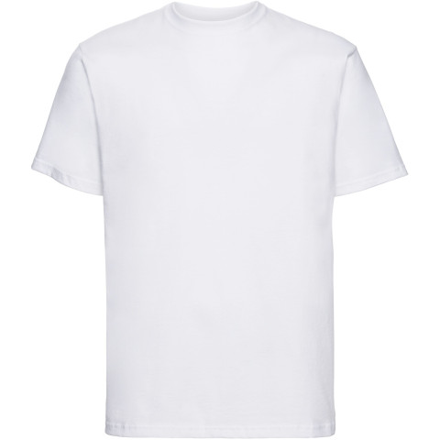
Task 2
Brain storm ideas and concepts for your slogan t-shirt.
Ask you self the following questions:
What am I passionate about?
What do I want to say?
Why do I want to say it?
Who is my target audience?
What can I use to communicate this?
Gather visual sources relating to the them you wish to communicate and put them in your sketchbook..
Use images from magazines, the internet, books etc.
Responded to these images with your own sketches / paintings / collages.
?

Slide 5
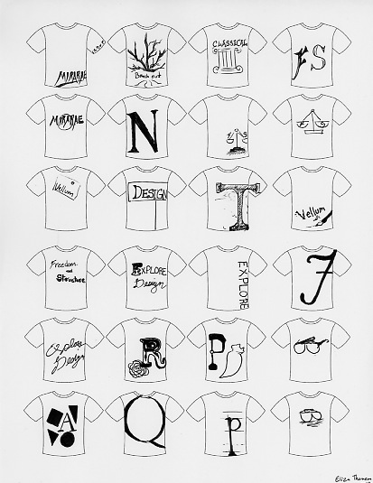
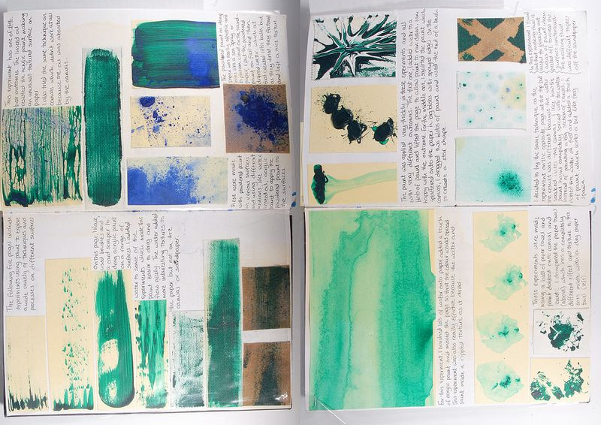
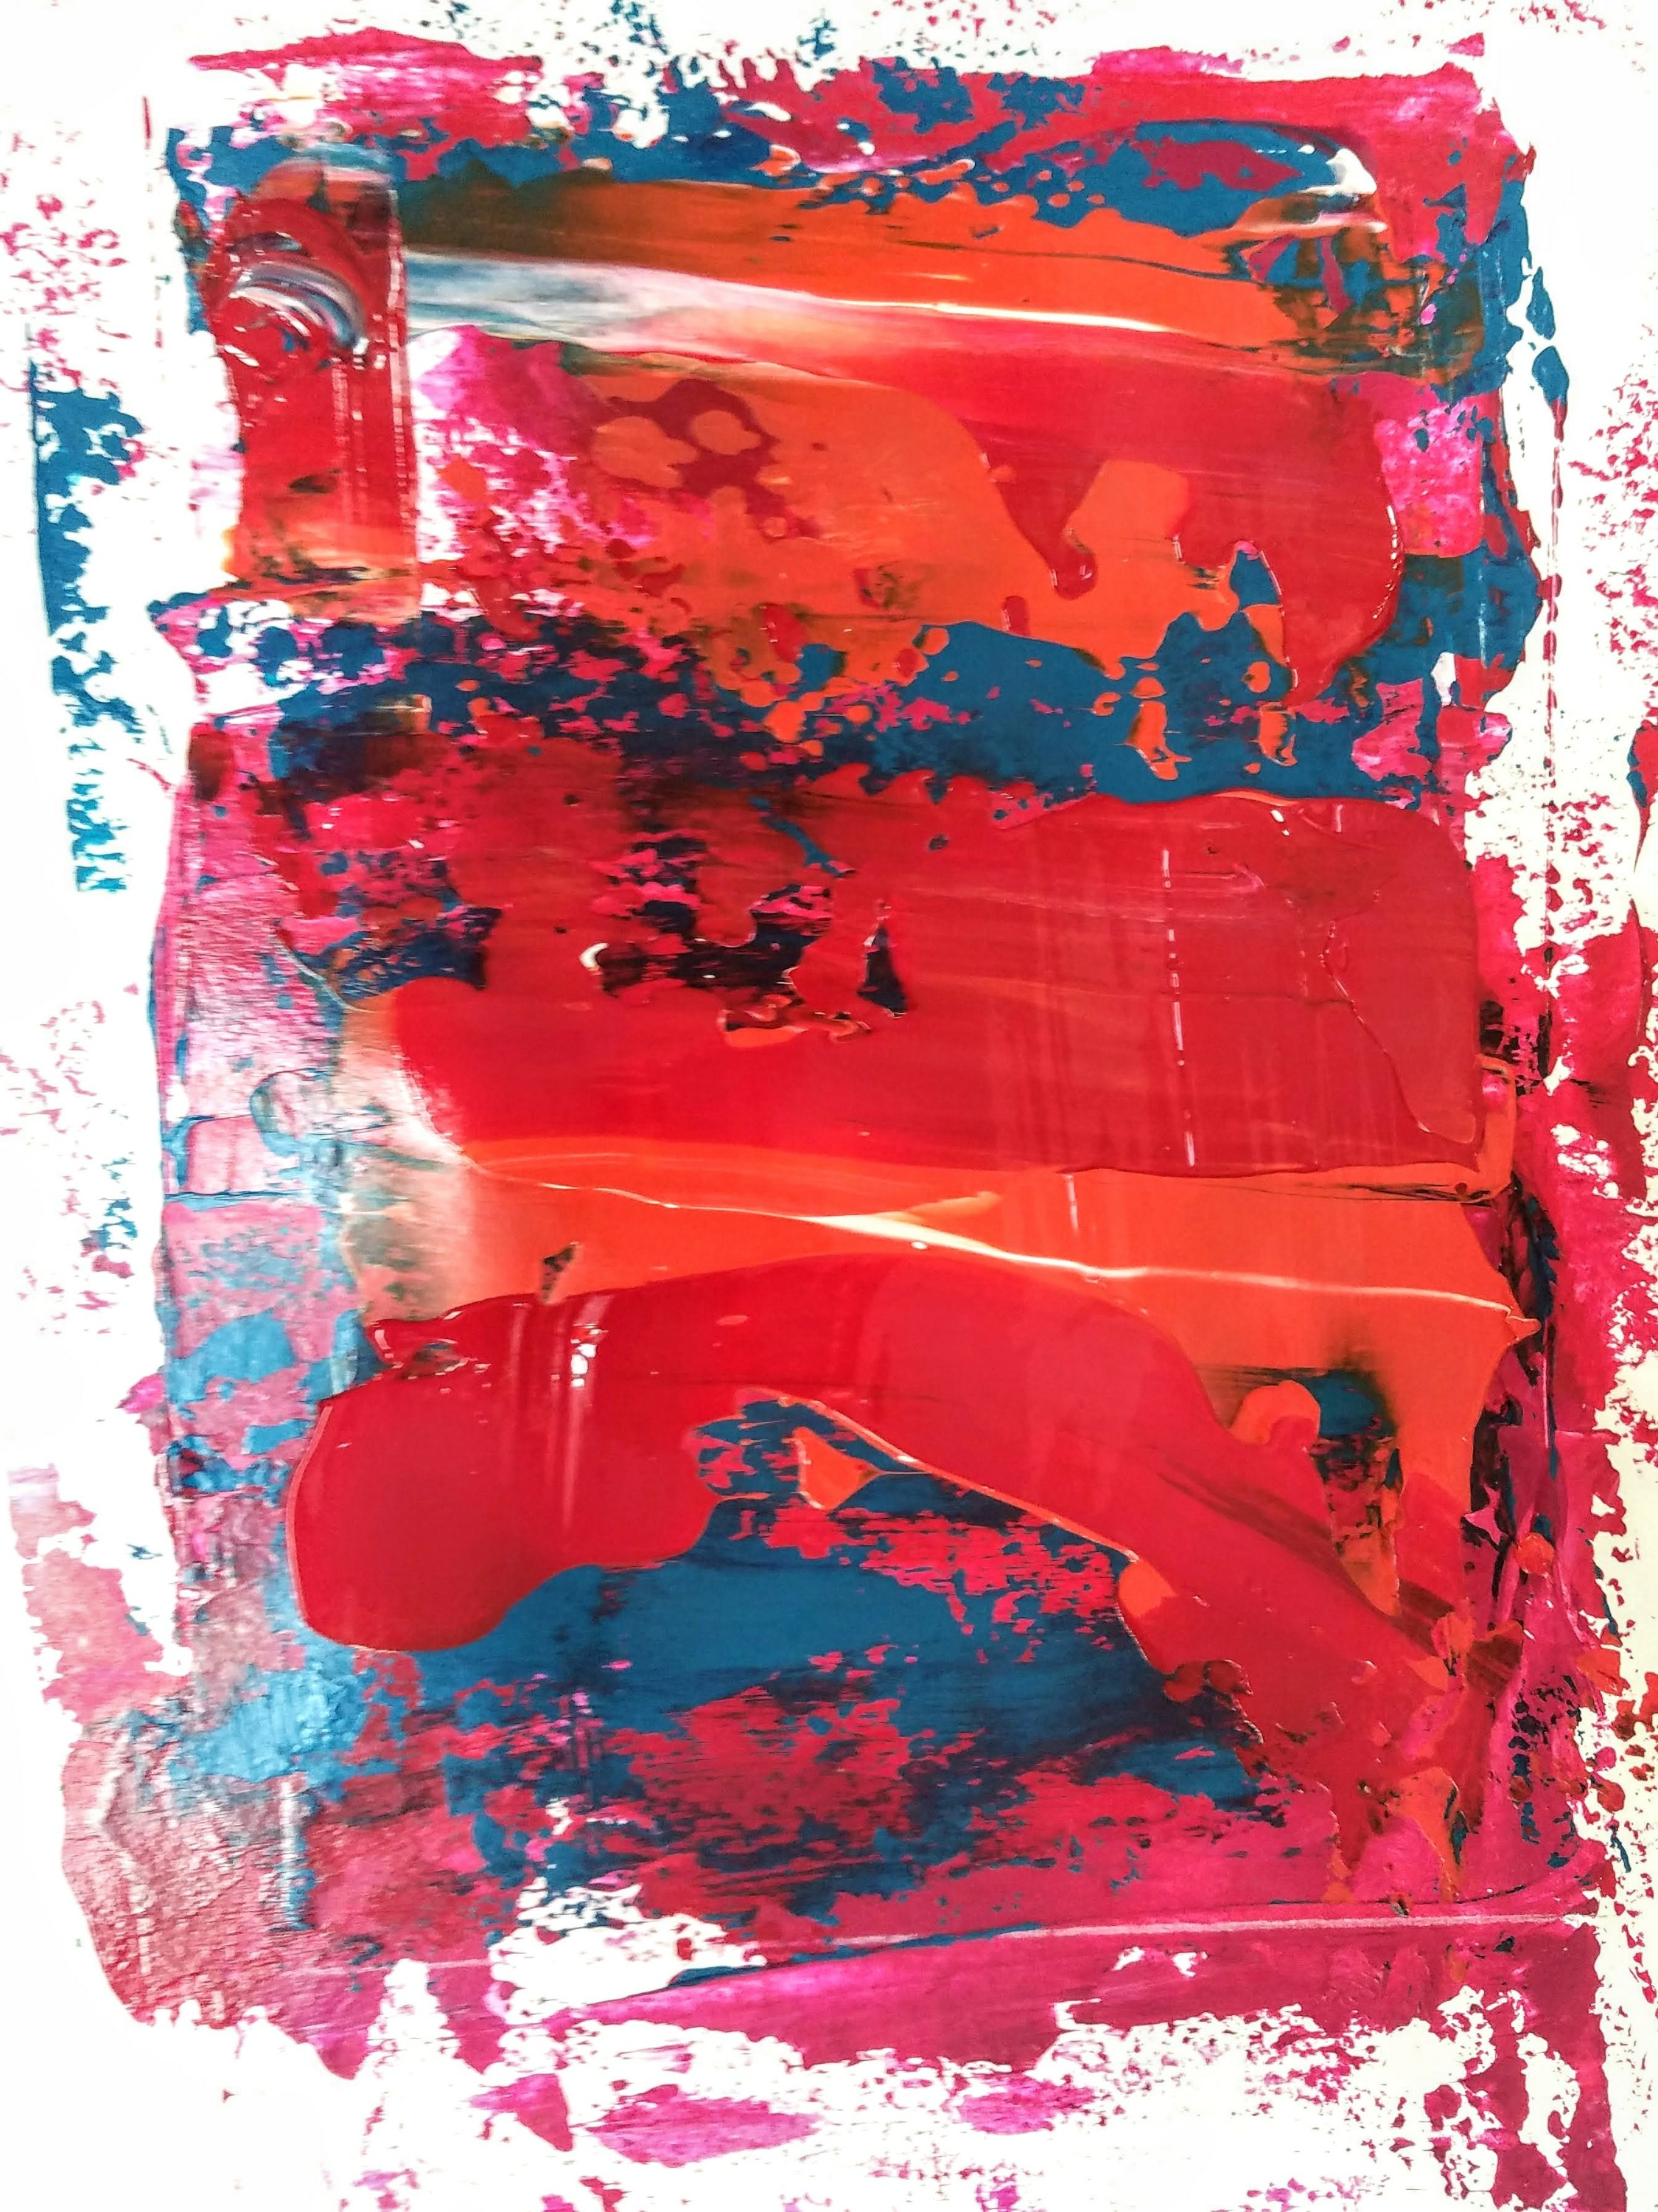
Task 3
Create thumbnail sketches' / designs.
Experiment with different colours / textures / scale / text

Slide 6
Vivienne Westwood
Vivienne Westwood's T-shirt draws attention to climate change

Slide 7
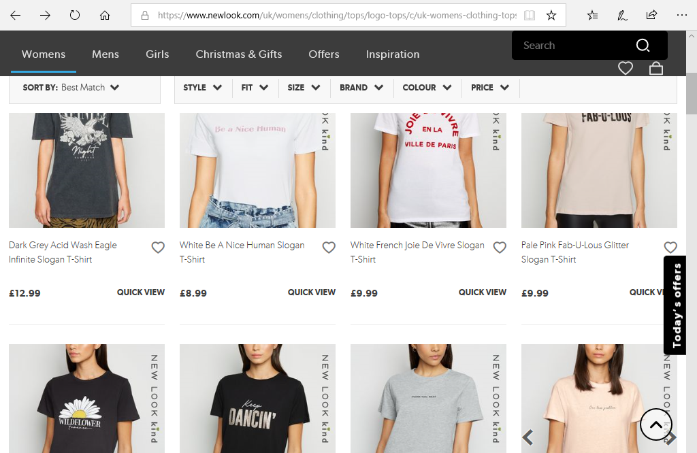

Slide 8
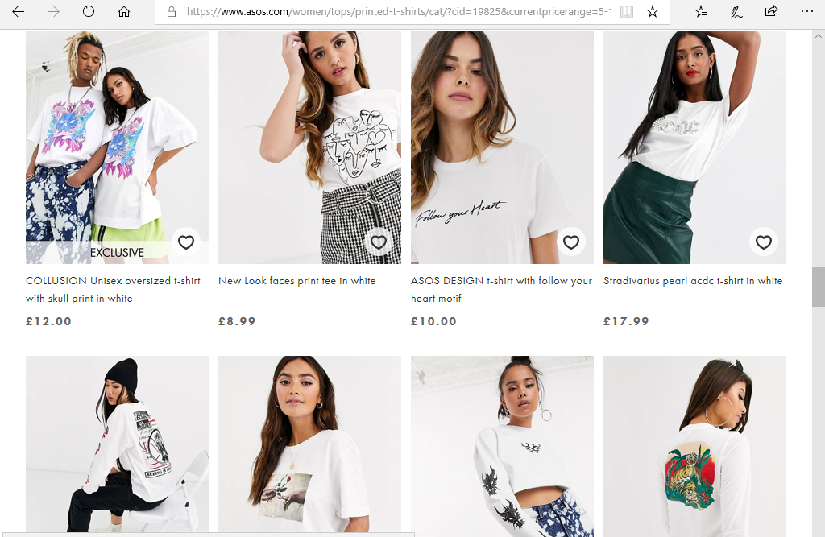

Slide 9
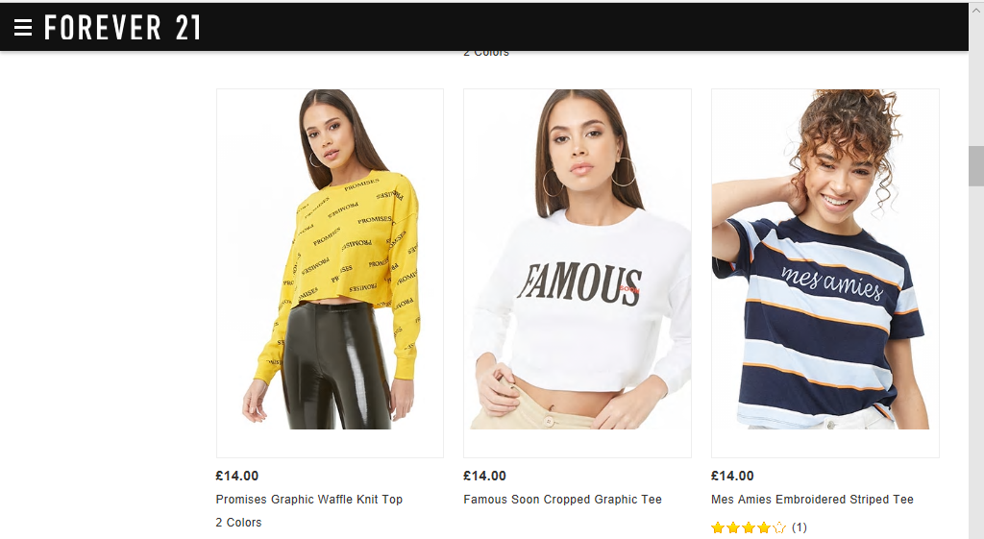

Slide 10
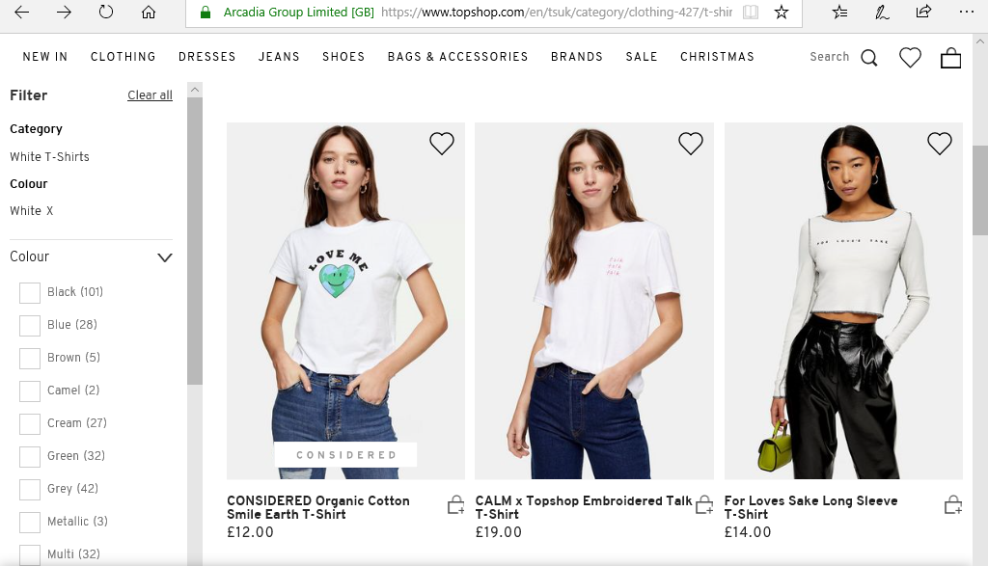

Slide 12
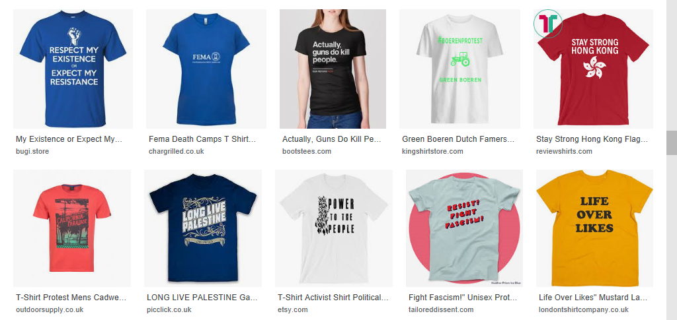

Slide 13
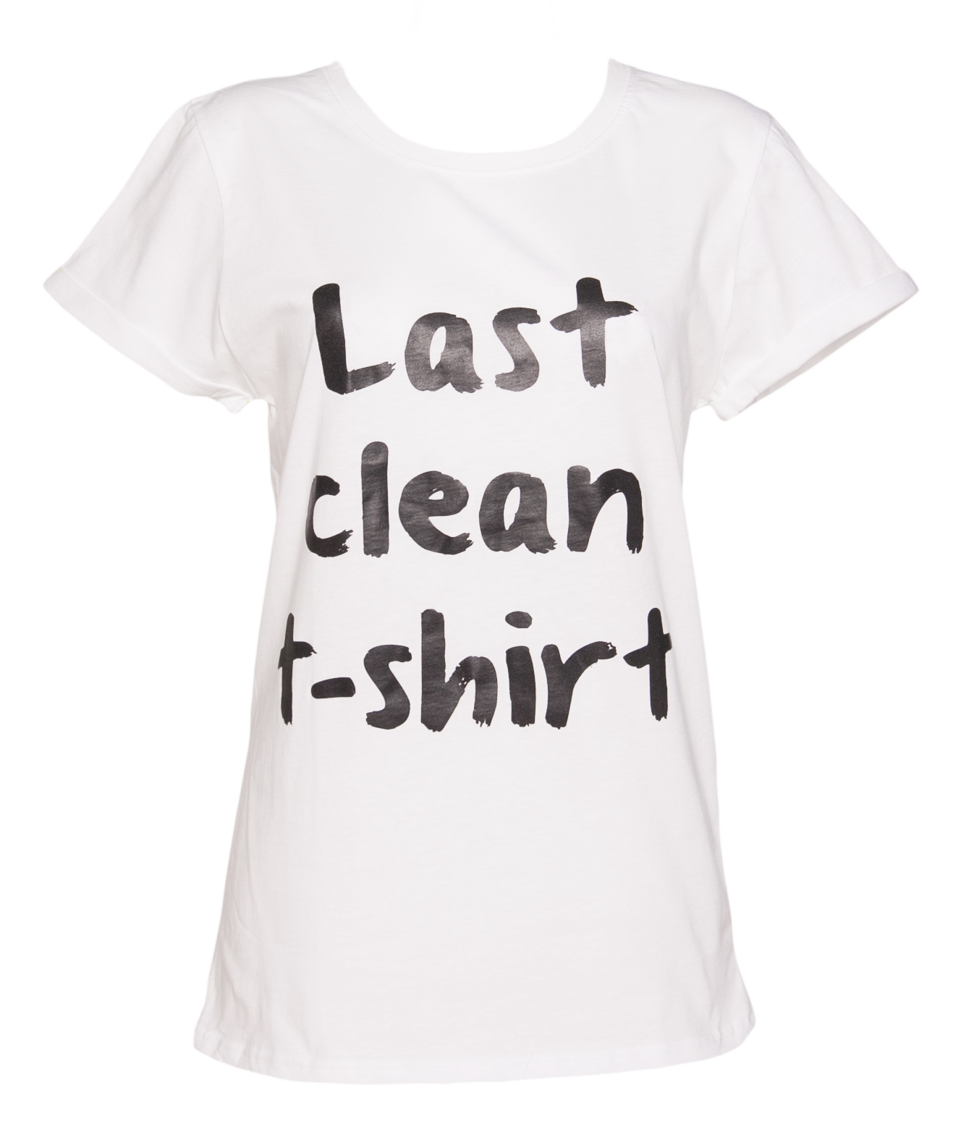
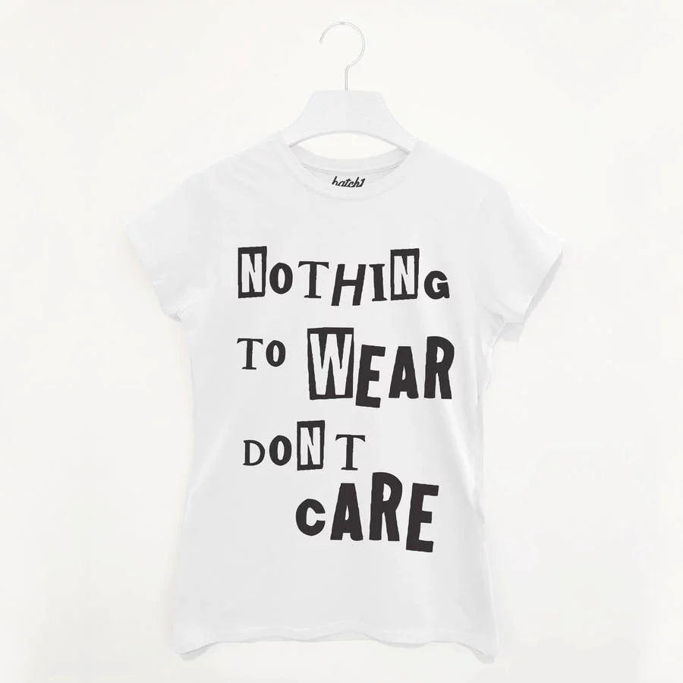
Choosing a print method
Things to consider:
Cost
Time
Reliability
Look

Slide 14
Costings
Transfer printing
Sheets = £15 for 20 A4 sheets.
Heat press = £150
T-shirt = £3 per t-shirt
Heat transfer using paints
£6 per bottle which paints 50 A4 sheets
Heat press = £150
T-shirt = £3
Screen printing
Professionally printed: 100 for £295 (inc t-shirt, one colour).
Work out how much it would cost to create 100 t-shirts and which method would be most cost and time effective.
You must take into consideration the pros and cons of each process.
How many colours could you print?
Will it create the "look" you want (e.g. vintage, unique, textured, bold, etc).
How time consuming will it be?

